Slide 1
Used vehicles

Slide 2
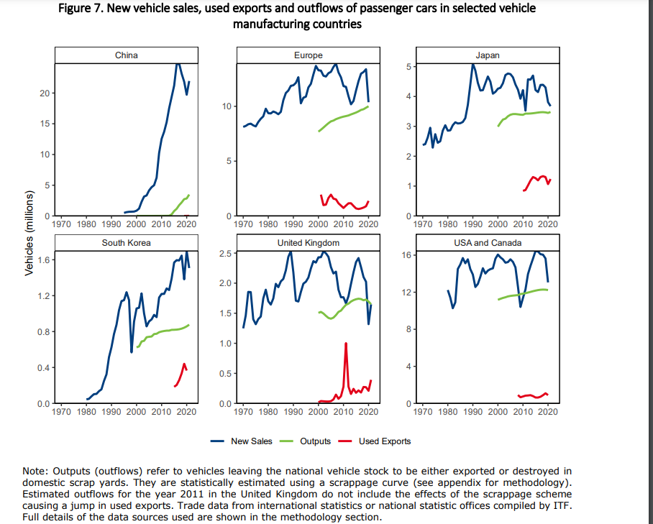
https://www.itf-oecd.org/sites/default/files/docs/new-but-used-electric-vehicle-global-second-hand-car-trade_0.pdf

